Slide 1


Code, Commit, Collaborate, Conquer
Understanding the Git Flow
Presenter
Mohammad Anees Alam
Notes:
1.7.2013
1
‹#›

Slide 2
Topics for Today!
Recap of GIT fundamentals
Managing GIT as DevOps
1
2
Necessary GIT Commands
Different hosting services
3
4
Githooks, Submodules, Subtrees
Open source contributions
5
6
Notes:
1.7.2013
2
‹#›

Slide 3
Pre-requisites
GIT setup on your system
1
GitHub account signed up
2
SSH connection
3
Notes:
1.7.2013
2
‹#›

Slide 4



Repository Setup
Fork
2
Create a duplicate of other’s repo in your github account.
git init
1
When you want to build from scratch locally.
3
git clone
Replicate the remote repository in local.
Notes:
1.7.2013
9
‹#›

Slide 5


Commit - Branch - Merge
Commit
Branches & Merge
Notes:
1.7.2013
4
‹#›

Slide 6




Git Fundamentals
Commits
Branches
Merging
Finalize local changes for remote push. (Ready-to-Serve)
Isolated workspaces for different features or fixes.
Combining changes from different branches into the main codebase.
Notes:
1.7.2013
5
‹#›

Slide 7
Git Commands
git init
git clone
git add
git commit -m
1
2
3
4
Initializes a new Git repository.
Clone a remote repository to local.
Adds files to the staging area.
Adds code changes to the branch with message (-m).
git push
git status
git log
git diff
5
6
7
8
Push local commits to remote repository.
Shows the current state of your working directory.
Displays the commit history.
To compare old & new versions.
git checkout -b
git branch
git merge
git --rebase
9
10
11
12
Create (-b) and switch to a branch.
Displays available branch in your Git repository.
Merge 'A' branch into your 'B' branch.
To update the local repository with online changes.
Notes:
1.7.2013
8
‹#›

Slide 8
Merging Strategies
When you merge, Git decides how to bring changes from one branch into another.
Fast-Forward Merge
Three-Way Merge
A fast-forward merge happens when the branch you’re merging into (usually main) has no new changes ahead since you created your feature branch.
Happens when both branches diverged (each has new commits).
Git creates a new merge commit.
Keeps history of parallel work.
Notes:
1.7.2013
12
‹#›

Slide 9
Let’s visualize Forward merge
Divergence means that when two branches (e.g., main and your private) have different commits that don’t exist in each other.
Case 1 – No Divergence
(Fast-Forward possible)
Case 2 – Diverged
(Fast-Forward not possible)
Rule of Thumb:
A --- B --- C (main)
\
D --- E (feature)
Here:
  main got commit C.
  feature got commits D and E.
Now both branches have unique commits.
  No divergence: Git performs a fast-forward (moves branch pointer).
  Divergence: Merge commit or rebase needed to combine histories.
A --- B (main)
\
C --- D (feature)
Here:
  main stopped at B.
  feature moved forward with C and D.
“Fast-forward merge: main updated as no new commits were added after branching.”
To bring them back together, Git must:
  Create a merge commit (normal merge), or
  Rebase feature onto main.
Notes:
1.7.2013
12
‹#›

Slide 10

Handling Conflicts
Conflicts in Git occur when changes to the same part of a file are made in different branches or during a merge.
Identify Conflict
Resolve Manually
Commit Resolution
    Git notifies of conflicting changes during merge.
    Edit conflicting files to choose desired changes.
    Once all conflicts are resolved and the files are staged, commit the changes and push to remote repository.
    Collaborate with change owners and decide which one to consider.
Notes:
1.7.2013
12
‹#›

Slide 11
To force a conflict : Hands-on Activity !
You need to edit the same file, same line in both branches and merge them.
#1 On main branch
  echo "Hello from main" > conflict.txt
  git add conflict.txt
  git commit -m "main edit"
#2 Switch to private branch
  git checkout -b private
#3 Edit the same file, same line differently
  echo "Hello from private" > conflict.txt
  git add conflict.txt
  git commit -m "private edit"
#4 Switch back to main and edit again
  git checkout main
  echo "Another main change" > conflict.txt
  git add conflict.txt
  git commit -m "another main edit"
#5 Now try merging private into main
  git merge private
This time, both branches modified conflict.txt differently, so Git won’t know which line to keep → you’ll get a merge conflict.
Remove the formatting lines from the file and save it before merging again to resolve the conflict.

Slide 12



Code management
2
git pull
Get changes from the remote and merge them into your branch
git fetch
1
Downloads changes from remote → doesn’t merge automatically.
3
git rebase
reapply your commits on top of updated branch history. Keeps history linear & clean!
Notes:
1.7.2013
11
‹#›

Slide 13
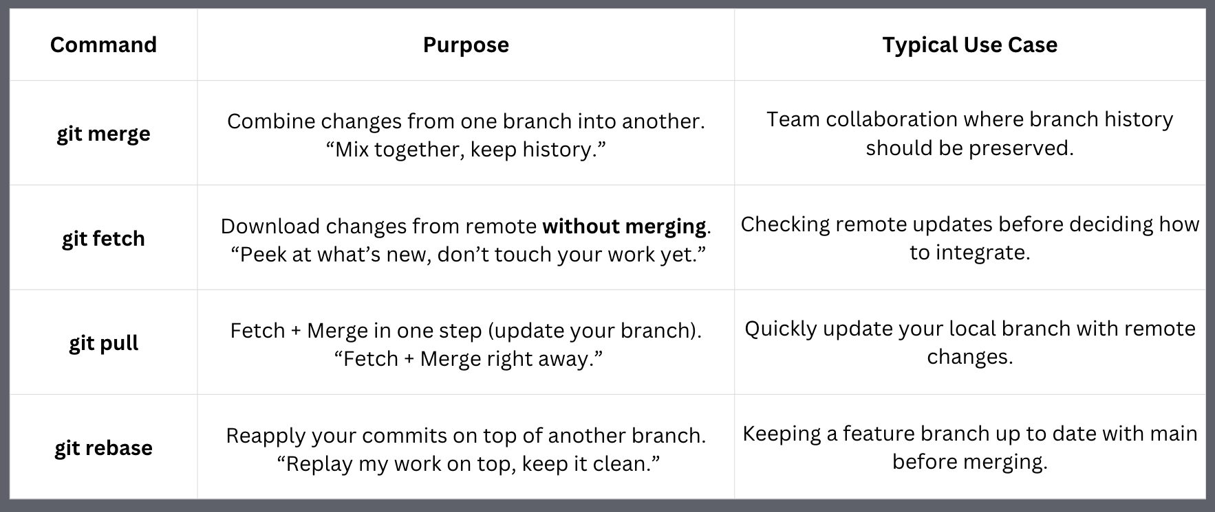
Merge - Fetch - Pull - Rebase

Slide 14

Git Repository Hosting Services
GitHub
GitLab
Bitbucket
Most popular for open-source projects.
Integrated CI/CD, useful for DevOps workflows.
Integrates well with Jira and Atlassian tools.
Notes:
1.7.2013
13
‹#›

Slide 15
Creating a Pull Request (PR)
A Pull Request is how you propose changes to someone else’s project.
A Pull Request means:
  “I made changes in my branch (maybe in my fork), and I’m requesting that you pull those changes into your branch (usually main).”
It’s not the same as the git pull command.
You can review code, discuss changes, and merge only when approved.
How to observe this?
  If you clone a public repo, make changes in your new branch (private), and push them, GitHub will prompt a “Compare & Pull Request” option in the original repository.

Slide 16
Repository management
2
Submodules
Repository inside a main repository.
Git Hooks
1
Gets triggered based on events in git.
3
Subtrees
Merge different repositories without managing sub-repositories.
Notes:
1.7.2013
11
‹#›

Slide 17
Hands-on Activity : Git Hooks
Common Git Hooks:
Pre-commit → Runs before a commit.
Use for code linting, formatting checks, or blocking bad commits.
Post-merge → Runs after a merge.
Use for updating dependencies or triggering build/test scripts.
# Create hook
cd .git/hooks
vim pre-commit
#!/bin/bash
if grep -q "TODO" *.txt; then
echo " Commit blocked! Remove TODOs first."
exit 1
fi
# Test
Commit with TODO in a .txt → blocked
Remove TODO → succeeds
# Make it executable
chmod +x pre-commit
Navigate back to your repo before committing.
STEP - 2
STEP - 3
STEP - 1
Notes:
1.7.2013
12
‹#›

Slide 18
Hands-on Activity : SubModules
Adding a Submodule:
# Start a new repo
  mkdir superproject && cd superproject
  git init
# Add a submodule
  git submodule add <Your-desired-Repo>
  git commit -m "Added submodule"
  git push -u origin main
Creates a libs/hello folder → linked to external repo.
# To clone a repository with submodules, use:
  git clone --recurse-submodules https://github.com/your/repository.git
Notes:
1.7.2013
12
‹#›

Slide 19
Hands-on Activity : SubTrees
Adding a Subtrees:
#1 Create main repo
  mkdir main-repo && cd main-repo
  git init
  echo "Main project file" > main.txt
  git add . && git commit -m "Initial commit in main"
#2 Create library repo
  cd ..
  mkdir lib-repo && cd lib-repo
  git init
  echo "Library file" > lib.txt
  git add . && git commit -m "Initial commit in lib"
#3 Add subtree
  cd ../main-repo
  git remote add lib ../lib-repo
  git subtree add --prefix=lib lib master --squash
lib/ folder from lib-repo now appears inside main-repo.
Notes:
1.7.2013
12
‹#›

Slide 20

Open Source Contributions
Fork Repository
1
Create a personal copy of the project.
Make Changes
2
Implement your contribution locally.
Submit Pull Request
3
Propose your changes to the original project.
Notes:
1.7.2013
14
‹#›

